Slide 1

Fundamental Concepts in Machine Learning Model Training (2)
Professor Bo Liu
James Watt School of Engineering

Slide 2
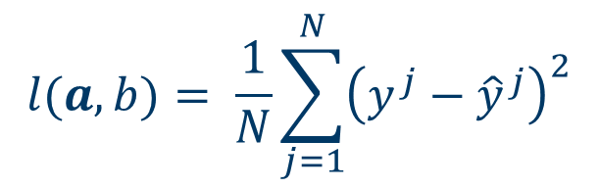

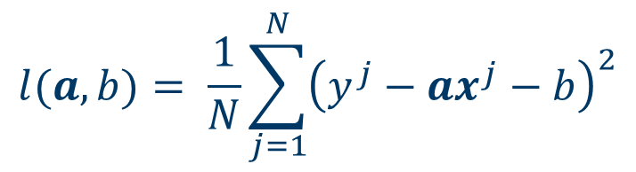
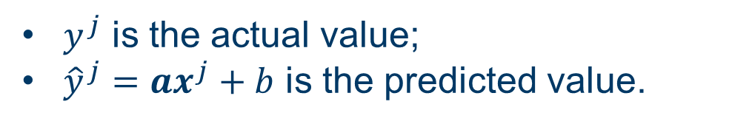
Training of a linear regression model
MSE is mostly used in LR to define the loss function:
$$l(a,b)= \frac{1}{N}\sum_{j=1}^{N}{{\left(y^{j}−{\hat{y}}^{j}\right)}^{2}}$$
$y^{j}$ is the actual value;
${\hat{y}}^{j}=ax^{j}+b$ is the predicted value.
Substitute the value of ${\hat{y}}^{j}$ yields
$$l(a,b)= \frac{1}{N}\sum_{j=1}^{N}{{\left(y^{j}−ax^{j}−b\right)}^{2}}$$

Slide 3
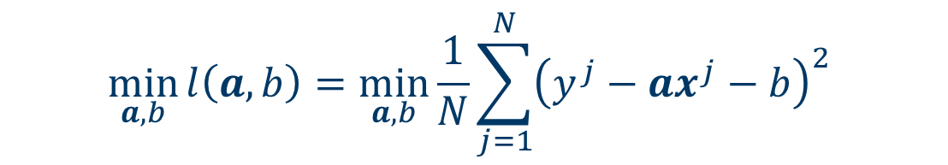
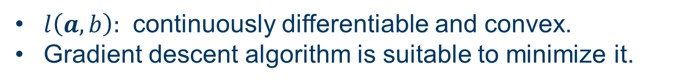
Linear regression: minimize the loss
Our goal is to minimize the loss.
That is, to minimize the unconstrained optimization problem:
$$\min_{a,b}{l\left(a,b\right)=\min_{a,b}{\frac{1}{N}\sum_{j=1}^{N}{{\left(y^{j}−ax^{j}−b\right)}^{2}} }}$$
$a,b$ are the decision variables to be optimized.
$l\left(a,b\right):$ continuously differentiable and convex.
Gradient descent algorithm is suitable to minimize it.

Slide 4
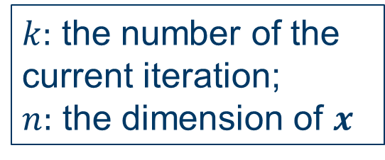
Minimize loss function: the gradient descent method
Gradient descent is a first-order iterative optimization algorithm for finding the local minima of a differentiable function.
Gradient descent iteration:
$x^{k+1}=x^{k}−α^{k}∇l(x^{k})$ (1)
$α^{k}>0$ is the step size, also called learning rate in ML.
$∇l(x^{k})$ is the gradient of $l$ at the point $x^{k}$ :
$∇l(x^{k})$ = $\left[\begin{aligned}\begin{matrix}\frac{∂l}{∂x_{1}^{k}} \\ \frac{∂l}{∂x_{2}^{k}} \\ ⋮\end{matrix} \\ \frac{∂l}{∂x_{n}^{k}}\end{aligned}\right]$
$k:$ the number of the current iteration;
$n:$ the dimension of $x$

Slide 5
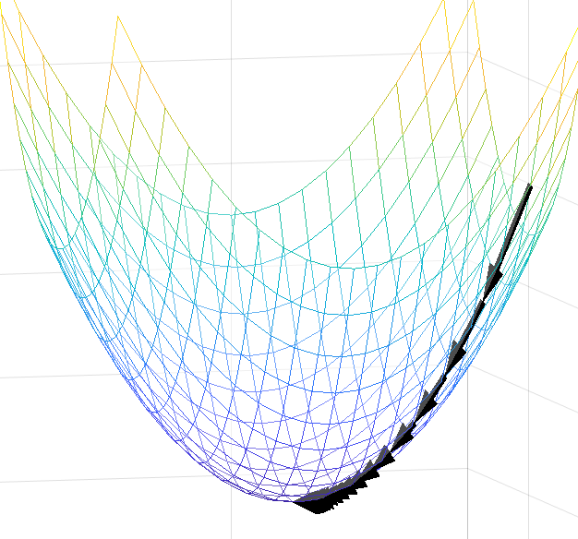
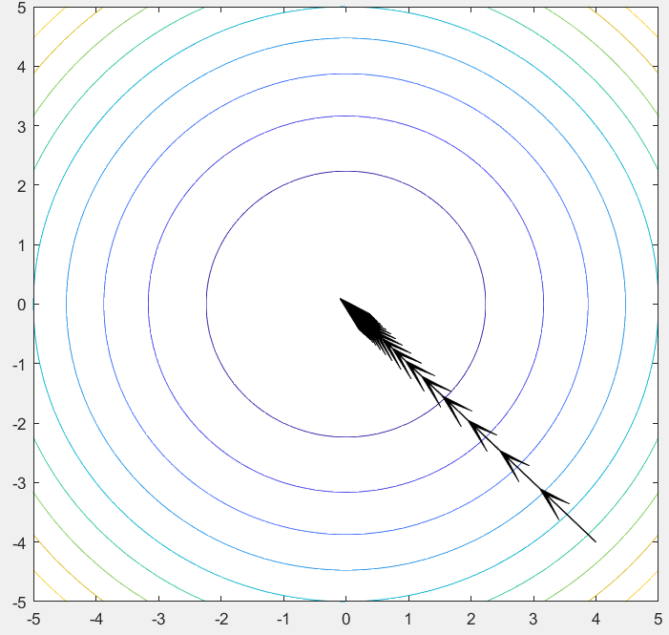

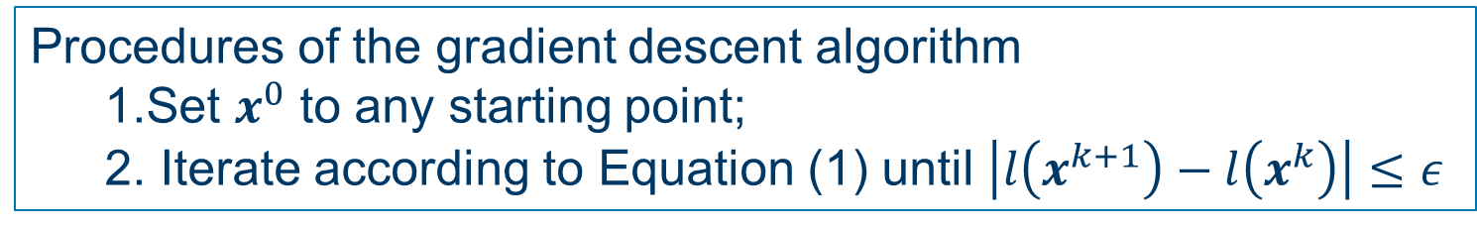


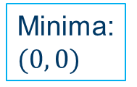
Minimize loss function: gradient descent algorithm
Procedures of the gradient descent algorithm
  Set $x^{0}$ to any starting point;
  Iterate according to Equation (1) until $\left|l\left(x^{k+1}\right)−l\left(x^{k}\right)\right|≤ε$
Example: gradient descent algorithm to minimize:
$l\left(x_{1},x_{2}\right)=x_{1}^{2}+x_{2}^{2}$
Minima: $(0, 0)$
Graph of $l$
Contour of $l$

Slide 6




Thanks!
#UofGWorldChangers
@UofGlasgow

